Slide 1
Regional CTO Pack for Technical Excellence 2019
David Stevens & Artie Kalemeris

Slide 2
Introduction
Between Sept 1st and the 17th 62 solutions have been submitted into Digital Explorer Solutions as candidates for regional nominations into a final review round for DXC Technical Excellence 2019
As regional CTO we need to you to select 1 solution per category for you to bring forward into the final review round
Your selections need to be returned to the ITP mailbox by …..

Slide 3
Selection Process
Review brief descriptions here, there is 1 or 2 slides for each regional
Review detailed datasheet within Digital Explorer
OPTIONAL : Rate and comment within DE (note this will be visible to all DXC employees) see slide 16
REQUIRED: Complete the table on slide 15 with your selectins
OPTIONAL: Request the solution contacts to enrich their solutions further to prepare for the next set of reviews

Slide 4
The categories
Agile Applications and Digital Experiences
Enabling the Enterprise Through Hybrid Cloud
Empowering Workforces with Invisible IT
Thriving on Enterprise Data and Analytics
Managing Enterprise Risk in a Connected World
Industry Specific Transformation
You can review detailed information about the Technical Excellence program here : https://my.dxc.com/our-company/global-functions/technology-office/dxc-awards-for-technical-excellence-.html

Slide 5
List of submissions – AMS (1)
Solution Name | Account | Category | Direct Link
AppFit (“Application Fitness”) | P&G | Managing Enterprise Risk | Direct Link
Automated Backup Status and Configuration Reporting | General Electric Company | Agile Applications and Digital Experiences | Direct Link
 |  | Enterprise Data and Analytics
Backup Data Center Consolidation | Zurich | Hybrid Cloud Platform | Direct Link
Cognitive Claims Straight-Through Processing Solution | Zurich | Agile Applications and Digital Experiences | Direct Link
 |  | Industry-Specific Transformation
Digital Transformation - Crew Training Instructor Self Scheduling Responsive Web Application | American Airlines | Agile Applications and Digital Experiences | Direct Link
Downgrade and Restore MS SQL Server Enterprise Featured Legacy Application Database to Standard Edition of Same Version or Higher | National Grid | Enterprise Data and Analytics | Direct Link
 |  | Industry-Specific Transformation
EMMA - Enhanced Machine learning & Multilayered Analytics for P&G | P&G | Enterprise Data and Analytics | Direct Link
Hybrid Cloud High Performance Computing (HPC) | United Technologies Corporation | Hybrid Cloud Platform | Direct Link
Managed Services for Microsoft Azure - CloudOps | CIBC | Agile Applications and Digital Experiences | Direct Link
 |  | Hybrid Cloud Platform
Notes:
match (s:Solution)--(t:Tag {name:'Technical Excellence 2019'})
optional match (s)--(si:SubIndustry)--(i:Industry)
optional match (s)--(r:Region)
optional match (s)--(a:Account)
optional match (s)--(c:Category)
return DISTINCT s.name as Name ,s.elevatorPitch as ElevatorPitch, c.name as Category, id(s) as SolutionID, s.createdBy as CreatedBy,r.name as Region,a.name as Account, i.name as Industry

Slide 6
List of submissions – AMS (2)
Solution Name | Account | Category | Direct Link
MMIS Healthcare Localization English & Spanish for Puerto Rico DDI | None given | Industry-Specific Transformation | Direct Link
Modernize Legacy COBOL system to Java Spring | California Dept. of Social Services | Agile Applications and Digital Experiences | Direct Link
 |  | Hybrid Cloud Platform
My_Enterprise_Portal | None given | Digital Workplace Transformation | Direct Link
Plant IT Virtual Platform Automation | P&G | Agile Applications and Digital Experiences | Direct Link
Quote Generation with smart speakers | Farmers (Zurich) | Industry-Specific Transformation | Direct Link
Reinsurance on the Blockchain with permissioned ledger | Farmers (Zurich) | Industry-Specific Transformation | Direct Link
Social Services Program - Advanced Data and Analytics Capabilities | California Dept. of Social Services | Enterprise Data and Analytics | Direct Link
Tops Markets IT Transformation | Tops markets | Hybrid Cloud Platform | Direct Link
 |  | Industry-Specific Transformation
 |  | Digital Workplace Transformation
Notes:
match (s:Solution)--(t:Tag {name:'Technical Excellence 2019'})
optional match (s)--(si:SubIndustry)--(i:Industry)
optional match (s)--(r:Region)
optional match (s)--(a:Account)
optional match (s)--(c:Category)
return DISTINCT s.name as Name ,s.elevatorPitch as ElevatorPitch, c.name as Category, id(s) as SolutionID, s.createdBy as CreatedBy,r.name as Region,a.name as Account, i.name as Industry

Slide 7
List of submissions - ANZ
Solution Name | Account | Category | Direct Link
Automated Backup Status and Configuration Reporting | General Electric Company | Agile Applications and Digital Experiences | Direct Link
 |  | Enterprise Data and Analytics
Essential Energy Smart AR Checklist | None given | Agile Applications and Digital Experiences | Direct Link
 |  | Enterprise Data and Analytics
Marksmanship application | None given | Agile Applications and Digital Experiences | Direct Link
React Blockchain Demo | None given | Agile Applications and Digital Experiences | Direct Link
XR (Mixed Reality) Forensics | None given | Agile Applications and Digital Experiences | Direct Link
 |  | Enterprise Data and Analytics
Notes:
match (s:Solution)--(t:Tag {name:'Technical Excellence 2019'})
optional match (s)--(si:SubIndustry)--(i:Industry)
optional match (s)--(r:Region)
optional match (s)--(a:Account)
optional match (s)--(c:Category)
return DISTINCT s.name as Name ,s.elevatorPitch as ElevatorPirch,r.name as Region ,a.name as Account, i.name as Industry, c.name as Category, id(s) as SolutionID, s.createdBy as CreatedBy

Slide 8
List of submissions - ASIA
Solution Name | Account | Category | Direct Link
Automated Backup Status and Configuration Reporting | General Electric Company | Agile Applications and Digital Experiences | Direct Link
 |  | Enterprise Data and Analytics
Digital Warehouse Personnel Health Evaluation system. | None given | Industry-Specific Transformation | Direct Link
Downgrade and Restore MS SQL Server Enterprise Featured Legacy Application Database to Standard Edition of Same Version or Higher | National Grid | Enterprise Data and Analytics | Direct Link
 |  | Industry-Specific Transformation
India Post Bank Countrywide Banking Solution | India Post | Agile Applications and Digital Experiences | Direct Link
ePOS - Electronic Point of Sales for Insurance | Manulife | Agile Applications and Digital Experiences | Direct Link
Firewall Rules Strategy & Improvement | None given | Managing Enterprise Risk | Direct Link
 |  | Agile Applications and Digital Experience
Notes:
match (s:Solution)--(t:Tag {name:'Technical Excellence 2019'})
optional match (s)--(si:SubIndustry)--(i:Industry)
optional match (s)--(r:Region)
optional match (s)--(a:Account)
optional match (s)--(c:Category)
return DISTINCT s.name as Name ,s.elevatorPitch as ElevatorPirch,r.name as Region ,a.name as Account, i.name as Industry, c.name as Category, id(s) as SolutionID, s.createdBy as CreatedBy

Slide 9
List of submissions – N & C Europe (1)
Solution Name | Account | Category | Direct Link
BASF Transformation from Traditional to Digital IT for Chemical Industry | BASF | Hybrid Cloud Platform | Direct Link
 |  | Industry-Specific Transformation | Direct Link
Creation of an image of organizational structure | None given | Enterprise Data and Analytics | Direct Link
CSAVAR | None given | Agile Applications and Digital Experiences | Direct Link
 |  | Industry-Specific Transformation | Direct Link
Daimler Price List | Daimler | Agile Applications and Digital Experiences | Direct Link
 |  | Digital Workplace Transformation | Direct Link
DevOps Integration for build & test phases of Zurich DE Life applications - Versicherungs Mathematisches Subsystem (VMS) | Zurich EMEA | Agile Applications and Digital Experiences | Direct Link
DMS (Document Management System) | None given | null | Direct Link
DTU set up and Agile and DevOps project solution | Zurich EMEA | Agile Applications and Digital Experiences | Direct Link
Dubai Analytics Smart City Platform | Dubai Smart City | null | Direct Link
DXC DevOps Composer | None given | Agile Applications and Digital Experiences | Direct Link
 |  | Hybrid Cloud Platform | Direct Link
Notes:
match (s:Solution)--(t:Tag {name:'Technical Excellence 2019'})
optional match (s)--(si:SubIndustry)--(i:Industry)
optional match (s)--(r:Region)
optional match (s)--(a:Account)
optional match (s)--(c:Category)
return DISTINCT s.name as Name ,s.elevatorPitch as ElevatorPirch,r.name as Region ,a.name as Account, i.name as Industry, c.name as Category, id(s) as SolutionID, s.createdBy as CreatedBy

Slide 10
List of submissions – N & C Europe (2)
Solution Name | Account | Category | Direct Link
DXC Medical Coding | None given | Enterprise Data and Analytics | Direct Link
 |  | Digital Workplace Transformation
Emergency Management System for Earthquakes | None given | Agile Applications and Digital Experiences | Direct Link
 |  | Industry-Specific Transformation
GVF (Global Vehicle File) | None given | Agile Applications and Digital Experiences | Direct Link
Kubernetes instant deploy - fully automated container platform deployment | None given | Agile Applications and Digital Experiences | Direct Link
 |  | Hybrid Cloud Platform
OneDrive migration project | None given | Digital Workplace Transformation | Direct Link
Package Automation Tool | None given | Agile Applications and Digital Experiences | Direct Link
Security patching and reporting automation using DXC Standard Toolset (BigFix) | General Electric Company | Agile Applications and Digital Experiences | Direct Link
 |  | Managing Enterprise Risk
State of the Region (SOTR) | None given | Managing Enterprise Risk | Direct Link
 |  | Digital Workplace Transformation
Notes:
match (s:Solution)--(t:Tag {name:'Technical Excellence 2019'})
optional match (s)--(si:SubIndustry)--(i:Industry)
optional match (s)--(r:Region)
optional match (s)--(a:Account)
optional match (s)--(c:Category)
return DISTINCT s.name as Name ,s.elevatorPitch as ElevatorPirch,r.name as Region ,a.name as Account, i.name as Industry, c.name as Category, id(s) as SolutionID, s.createdBy as CreatedBy

Slide 11
List of submissions – N & C Europe (3)
Solution Name | Account | Category | Direct Link
STILL neXXt Fleet Management | KION Group AG | Agile Applications and Digital Experiences | Direct Link
 |  | Enterprise Data and Analytics
TITR | None Given | Agile Applications and Digital Experiences | Direct Link
 |  | Enterprise Data and Analytics
Cloud based logistics path assembly | None given | Agile Applications and Digital Experiences | Direct Link
Notes:
match (s:Solution)--(t:Tag {name:'Technical Excellence 2019'})
optional match (s)--(si:SubIndustry)--(i:Industry)
optional match (s)--(r:Region)
optional match (s)--(a:Account)
optional match (s)--(c:Category)
return DISTINCT s.name as Name ,s.elevatorPitch as ElevatorPirch,r.name as Region ,a.name as Account, i.name as Industry, c.name as Category, id(s) as SolutionID, s.createdBy as CreatedBy

Slide 12
List of submissions – S Europe
Solution Name | Account | Category | Direct Link
DBaaS configuration in Oracle SuperCluster | Zurich EMEA | Enterprise Data and Analytics | Direct Link
Digital Government Experience Center (DGX) | None given | Agile Applications and Digital Experiences | Direct Link
 |  | Enterprise Data and Analytics
 |  | Managing Enterprise Risk
 |  | Hybrid Cloud Platform
 |  | Industry-Specific Transformation
 |  | Digital Workplace Transformation
DTU set up and Agile and DevOps project solution | Zurich EMEA | Agile Applications and Digital Experiences | Direct Link
DXC Lambda | Flemish Government | Agile Applications and Digital Experiences | Direct Link
 |  | Hybrid Cloud Platform
Hybrid IT Operation and Application devlopement considerations | None given | Hybrid Cloud Platform | Direct Link
Open (Government) Data Strategy & Operations | Flemish Government | Agile Applications and Digital Experiences | Direct Link
Serverless AWS Event Monitoring | None given | Hybrid Cloud Platform | Direct Link
The DGX Design Studio Workshop: Accelerate innovation through interactive co-creation and concept prototyping | None given | Agile Applications and Digital Experiences | Direct Link
Using data analytics to make roads safer | Flemish Government | Enterprise Data and Analytics | Direct Link
Notes:
match (s:Solution)--(t:Tag {name:'Technical Excellence 2019'})
optional match (s)--(si:SubIndustry)--(i:Industry)
optional match (s)--(r:Region)
optional match (s)--(a:Account)
optional match (s)--(c:Category)
return DISTINCT s.name as Name ,s.elevatorPitch as ElevatorPirch,r.name as Region ,a.name as Account, i.name as Industry, c.name as Category, id(s) as SolutionID, s.createdBy as CreatedBy

Slide 13
List of submissions – UKIIMEA (1)
Solution Name | Account | Category | Direct Link
Digital Innovation Platform | None given | Hybrid Cloud Platform | Direct Link
Downgrade and Restore MS SQL Server Enterprise Featured Legacy Application Database to Standard Edition of Same Version or Higher | National Grid | Enterprise Data and Analytics | Direct Link
 |  | Industry-Specific Transformation
Mobile solution for supporting Urgent Care | None given | Digital Workplace Transformation | Direct Link
My_Enterprise_Portal | None given | Digital Workplace Transformation | Direct Link
National Grid Separation | National Grid | Hybrid Cloud Platform | Direct Link
Personas | None given | Agile Applications and Digital Experiences | Direct Link
 |  | Industry-Specific Transformation
Notes:
match (s:Solution)--(t:Tag {name:'Technical Excellence 2019'})
optional match (s)--(si:SubIndustry)--(i:Industry)
optional match (s)--(r:Region)
optional match (s)--(a:Account)
optional match (s)--(c:Category)
return DISTINCT s.name as Name ,s.elevatorPitch as ElevatorPirch,r.name as Region ,a.name as Account, i.name as Industry, c.name as Category, id(s) as SolutionID, s.createdBy as CreatedBy

Slide 14
List of submissions – UKIIMEA (2)
Solution Name | Account | Category | Direct Link
Smart Factory - Internet of Things (IoT) | None given | Agile Applications and Digital Experiences | Direct Link
 |  | Enterprise Data and Analytics
 |  | Industry-Specific Transformation
 |  | Digital Workplace Transformation
IoT supply chain management | Seadrill Management Ltd | Digital Workplace Transformation | Direct Link
NDC Bulgaria | Royal Bank of Scotland | Agile Applications and Digital Experiences | Direct Link
Automated Notification Service | None given | Agile Applications and Digital Experiences | Direct Link
Bare-Metal to fully deployed Factory | None given | Industry-Specific Transformation | Direct Link
Email to Ticket | None given | Digital Workplace Transformation | Direct Link
Notes:
match (s:Solution)--(t:Tag {name:'Technical Excellence 2019'})
optional match (s)--(si:SubIndustry)--(i:Industry)
optional match (s)--(r:Region)
optional match (s)--(a:Account)
optional match (s)--(c:Category)
return DISTINCT s.name as Name ,s.elevatorPitch as ElevatorPirch,r.name as Region ,a.name as Account, i.name as Industry, c.name as Category, id(s) as SolutionID, s.createdBy as CreatedBy

Slide 15
YOUR CHOICES < REGION NAME HERE>
Solution Name | Account | Category | DE Link
 |  | Agile Applications and Digital Experiences
 |  | Enabling the Enterprise Through Hybrid Cloud
 |  | Empowering Workforces with Invisible IT
 |  | Thriving on Enterprise Data and Analytics
 |  | Managing Enterprise Risk in a Connected World
 |  | Industry Specific Transformation
Maximum of one per category
You do not have to position a solution into all categories

Slide 16
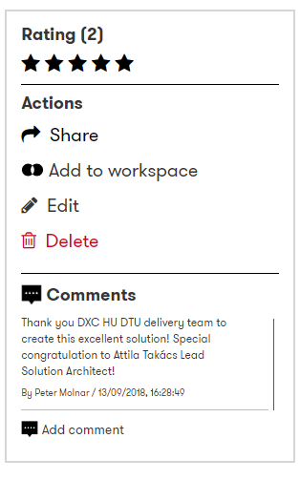
Rate and comment within Digital Explorer
As you review the solution within Digital Explorer, you have the option to use the ratings and comments option to provide direct feedback for the solution owners and also others who view the datasheet later.
Note : these comments are visible to anyone within DXC

Slide 17
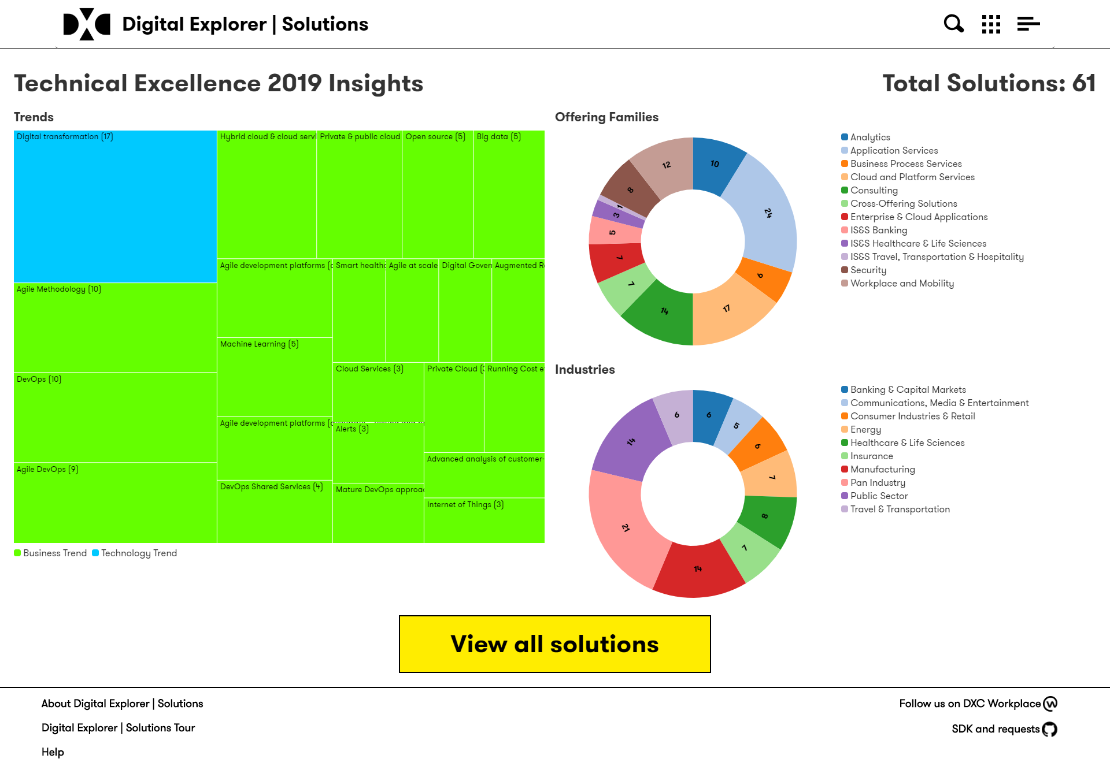
https://digitalexplorer.dxc.com/se/techexcellence/dashboard

